Slide 1
Culture Educational
Speaking
Being able to express your opinion
Listening
Active Listening with understanding
Creativity
Adding new thoughts to the discussion
Questions
Team Building
Asking poignant questions
.
“Live each day as if it is your last”
Follow your heart as you have nothing to lose
Follow your heart and intuition
The heaviness of being successful was replaced by the lightness of being a beginner again
Create a word bank for discussion
Stay hungry / Stay foolish
You have got to find what you love
Don’t settle
…
DON’T LOSE FAITH IN YOURSELF
Christopher Bauman – www.chrisbauman.com.au

Slide 2
1. Think of the thing that you love to do and describe it ____________________________________________________________________________________________?
Advanced Question Words
2. I had been rejected so I decided to start over ___________________________________________________________________________________________ ?
Something began to dawn on me
3. Describe a situation when you were a beginner ___________________________________________________________________________________________ ?
As it turned out
Relationships in education
4 Awful tasting medicine ___________________________________________________________________________________________ ?
5. What is something that has made an impression on you ___________________________________________________________________________________________ ?
Turn of events
Don’t settle
6. What is something that is truly important to you ___________________________________________________________________________________________ ?
What is your focus
Life’s change agent
Unsure
7. What does your own inner voice tell you ___________________________________________________________________________________________ ?
.
8. Describe 3 possibilities of what is at the end of your country road __________________________________________________________________________________ ?
.
What is a setback that you have experienced ….. The best thing that has ever happened to you.
Sometimes when you innovate you make mistakes, admit them and move on quickly.
Christopher Bauman – www.chrisbauman.com.au

Slide 3
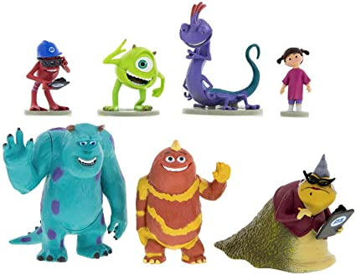
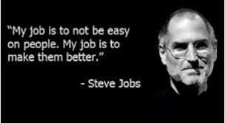
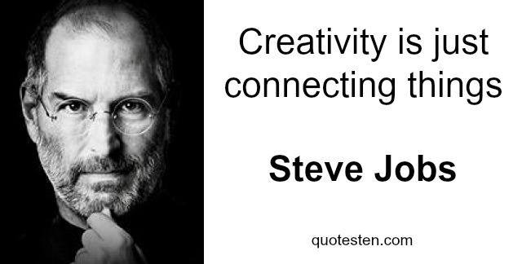
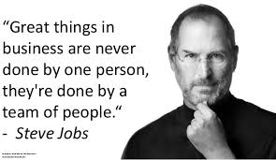
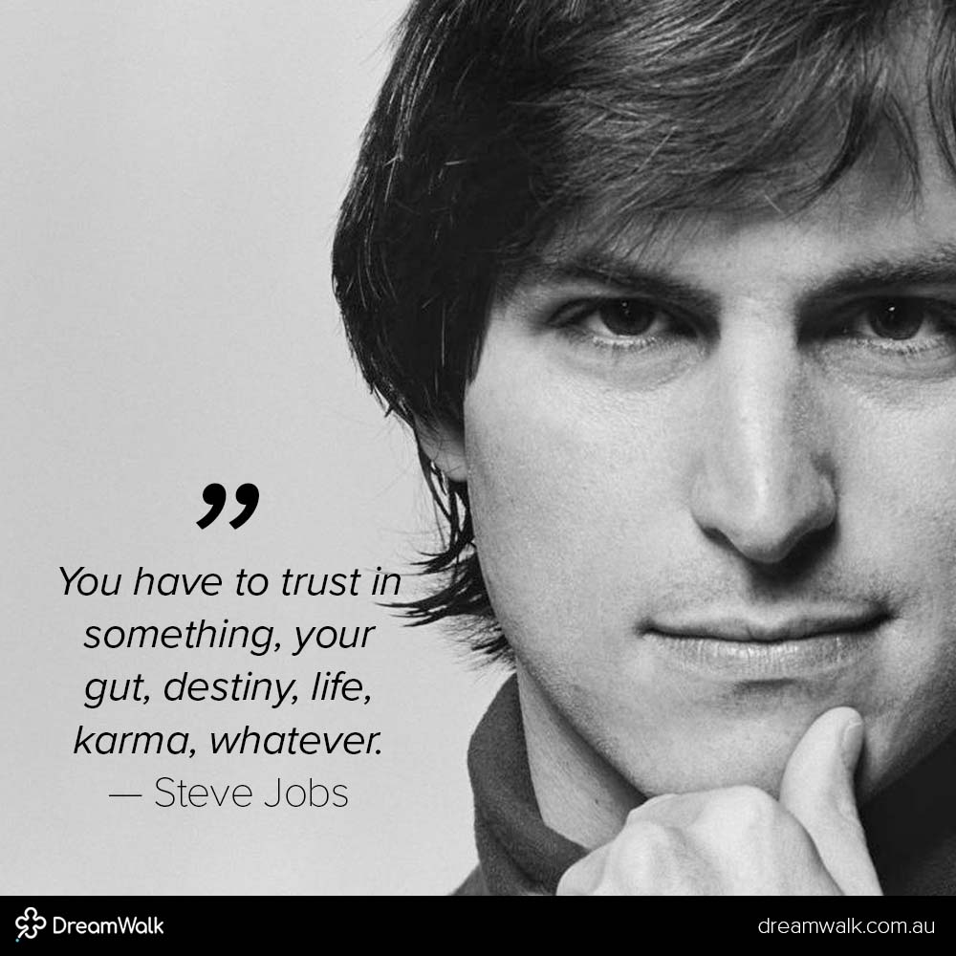
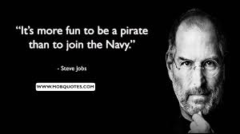
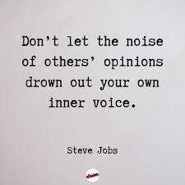
Influence
Think different
Time is valuable
What is great work
Inner voice
Opinions
What is something that you have learnt

